Slide 1
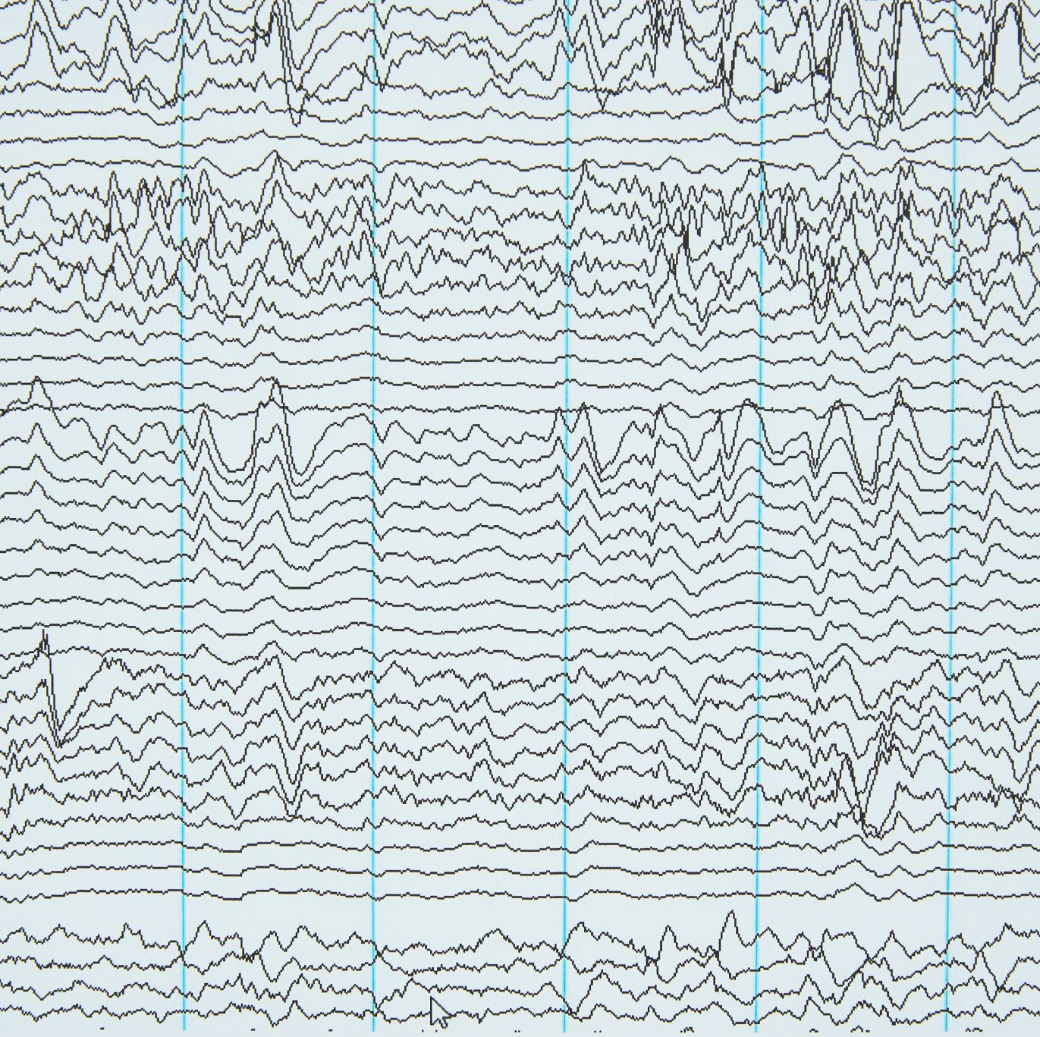
Telugu News Classification

Slide 2
REFERENCE 1 (Journal)
A Comparative Study on term weighting methods for automated Telegu text categorization with effective Classifiers
Vishnu Murty, Dr. B. Vishnu Vardhan, K.Sarngam , P. Vijay pal Reddy
Department of computer science and engneering, JNTU, jagital
International Journal of Data Mining and knowledge Management process, November 2013
DOI : 10.5121

Slide 3
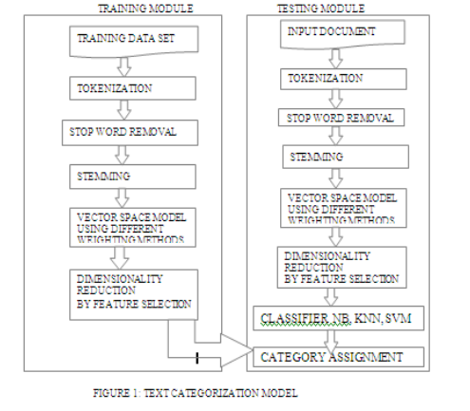
Methodology

Slide 4
VECTOR SPACE MODEL
The paper considers four different term weighting approaches for Telugu Text Categorization (TC). These approaches are as follows:
Term Frequency (TF): This method assigns a weight to each term proportional to the number of times it appears in the document.
Term Frequency-Inverse Document Frequency (TF-IDF): This approach combines TF and IDF to weight the terms. IDF reflects the importance of a term in a collection of documents. The combined result of TF and IDF is used as the weight for each term.
Term Frequency-Chi square (TF.CHI): This approach combines TF with the chi-square feature selection metric. It is included as a representation that combines TF with a feature selection technique.
Term Frequency-Relevance Frequency (TF.RF): This method, proposed for English documents, is considered the best term weighting approach for TC. It calculates the weight of a term based on the number of documents containing positive and negative category terms.

Slide 5
Classifiers
Naïve Bayes Algorithm:
Naive Bayes is a supervised, probabilistic learning method that calculates the conditional probability of a term occurring in a document of a specific class. It is used for text classification by considering the evidence contributed by each term. The maximum a posteriori (MAP) class is determined as the most likely class for a given document.
KNN Algorithm:
K-nearest neighbor (KNN) is a statistical approach applied to text classification. It searches for the K nearest neighbors among pre-classified training documents based on a similarity measure. The rankings of these neighbors, using similarity scores, are used to predict the category of the test document. The category with the highest score is assigned to the test document if it exceeds a predefined threshold.
Support Vector Machines (SVM):
SVM is a linear learning system used for building two-class classifiers. It finds a linear function that separates the input vectors into positive and negative classes. The weight vector and bias are determined to assign an input vector to the positive class if the function value is greater than or equal to zero, and to the negative class othrwise.

Slide 6
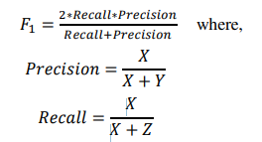
Empirical Evaluation
The evaluation of the classifiers involved computing precision, recall, F1 measure, and macro-averaged F1 measure. Precision represents the proportion of correctly labeled positive examples, while recall represents the proportion of truly positive examples that were labeled correctly. The F1 measure is computed using a specific equation. The macro-averaged F1 measure calculates the average F1 measure across all categories.

Slide 7
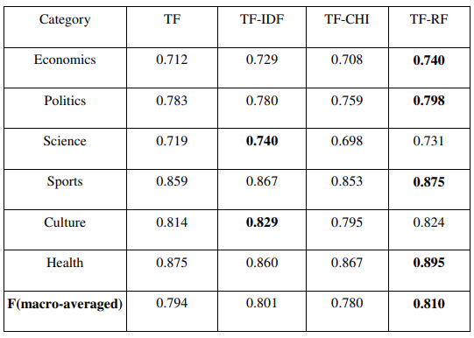
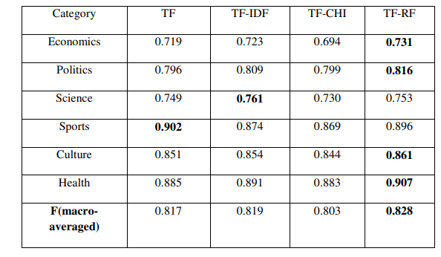
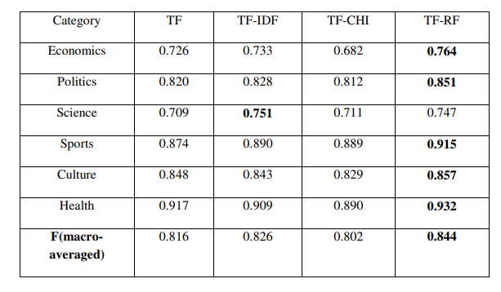
Results
SVM
KNN
Naïve Bayes
After analyzing the results, They found that the SVM categorizer outperformed NB and KNN on six data sets with regards to F1 and macro averaged-F results. TF-RF performs significantly better for all category distributions. Best macro averaged-F is achieved by using the TF-RF scheme.

Slide 8
REFERENCE 2 (Conference)
"Comparative Study on Telugu text Classification using Machine Learning and Deep Learning models"
V. Gampala, J. Vallapuneni, P. Kumar Ande, R. Kumar Indurthi and N. Rajesh
2021 5th International Conference on Trends in Electronics and Informatics (ICOEI), Tirunelveli, India, 2021, pp. 1393-1398, doi: 10.1109/ICOEI51242.2021.9453040.

Slide 9
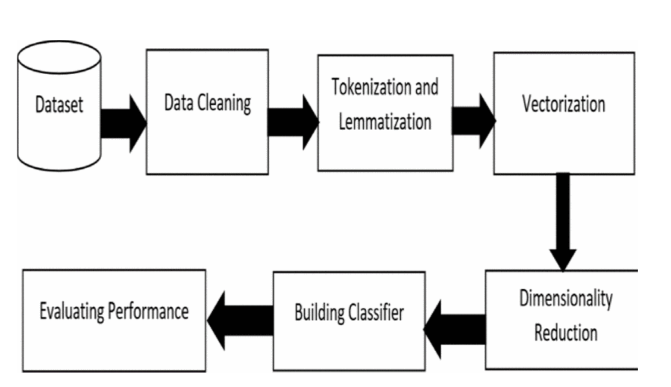
Methodology

Slide 10
Classifiers
Naive Bayes classification is an efficient algorithm that assumes the independence of features and calculates the likelihood of a text belonging to a specific category.
Support Vector Machine (SVM) is a model used for classification and regression problems. It constructs a hyperplane in the feature space to separate different classes.
Neural Network (NN) is a group of methodologies inspired by the human brain's functionality. NN recognizes hidden patterns and relationships in data through interconnected nodes arranged in layers.

Slide 11
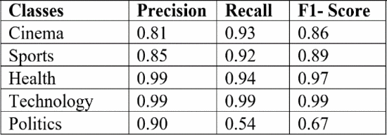
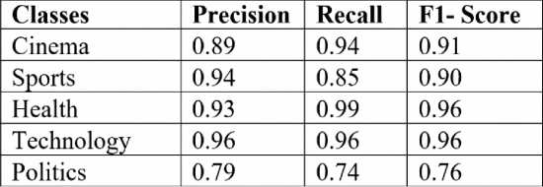
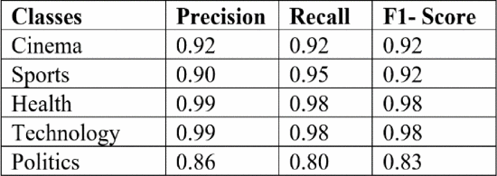
RESULTS
SVM
The overall accuracy of SVM is 87% and NB is 92% and neural network is 90%. The Health and Technology classes have almost same accuracy among all the classifiers. Politics class is showing poor F1- score of 67% for the SVM classifier.
Neural Network
Naïve Bayes

Slide 12
REFERENCE 3
News Text Classification Based on Improved Bi-LSTM-CNN
C. Li, G. Zhan and Z. Li," 2018 9th International Conference on Information Technology in Medicine and Education (ITME), Hangzhou, China, 2018, pp. 890-893, doi: 10.1109/ITME.2018.00199.

Slide 13
INTRODUCTION
This paper proposes the use of the Bi-LSTM-CNN model for efficiently classifying large-scale news text. Traditional methods have limitations in capturing context and dealing with data sparsity and dimension explosion.
The Bi-LSTM-CNN model addresses these challenges by capturing representations from both directions and combining them through a convolutional neural network.
Experimental results using a subset of the THUCNews dataset demonstrate the superior performance of the proposed model compared to other benchmark models.

Slide 14
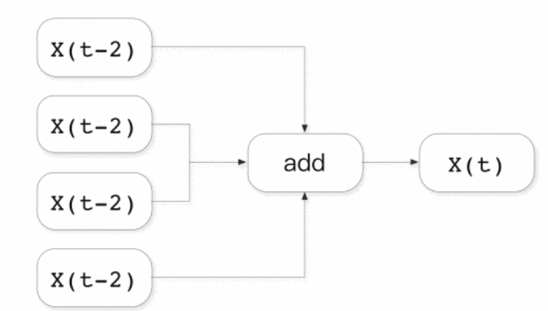
Word Vector Training Based on word2vec
This paper applies the CBOW model of Word2vec for training word vectors. CBOW assumes that a word's meaning is influenced by the surrounding words within a given context window.
The model consists of an input layer with 2 word vectors representing the context of a word xi, a projection layer that sums the word vectors to create a vector Sx, and an output layer represented by a Huffman tree with weights based on corpus occurrences.
The objective is to optimize the CBOW model using gradient descent.

Slide 15
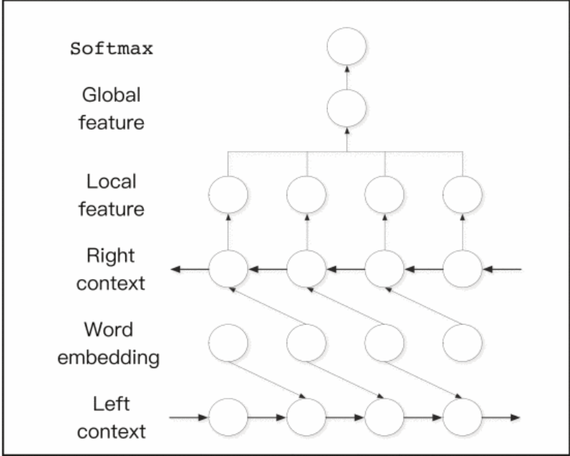
Model Bi-LSTM

Slide 16
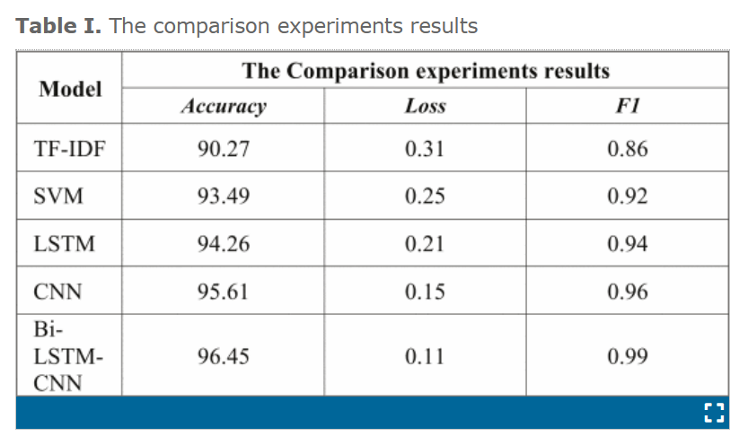
Result
the classification methods of TF-IDF, SVM, CNN and LSTM are mainly used for comparison experiments.. The main indicators for evaluating text classification are the following: Accuracy Rate, Loss Rate, and F1 score.

Slide 17
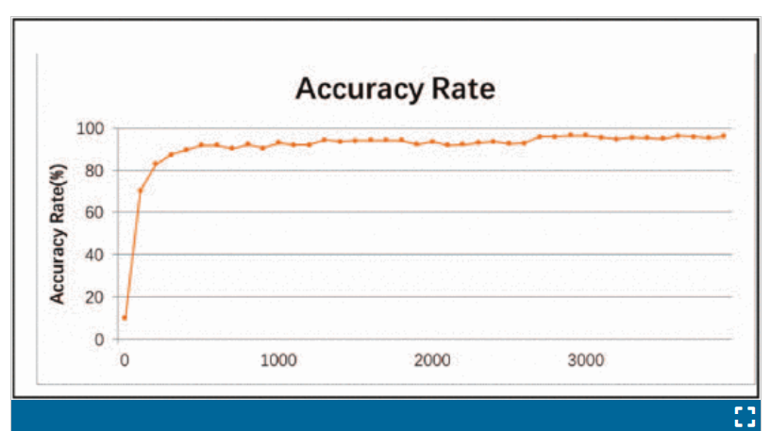
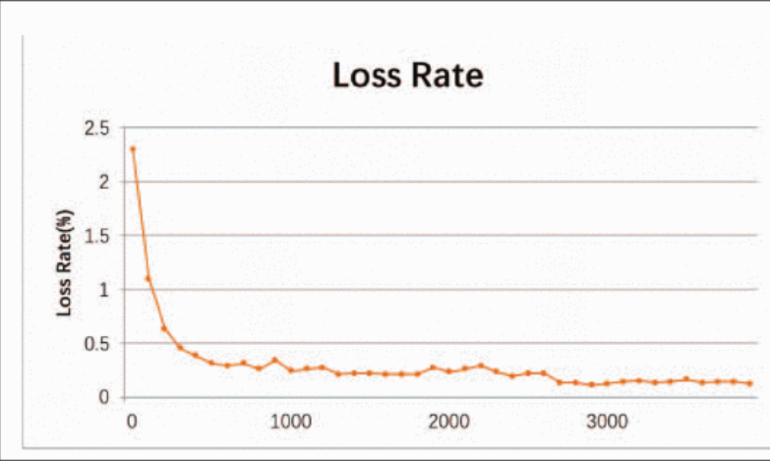
Result
Cross-validation is used to prevent overfitting, with different test and training sets. The model's accuracy gradually improves while the loss rate steadily decreases. Stability is observed in both metrics when the training data reaches 1,800 instances. These findings indicate the effectiveness and reliability of the proposed model.

